Slide 1
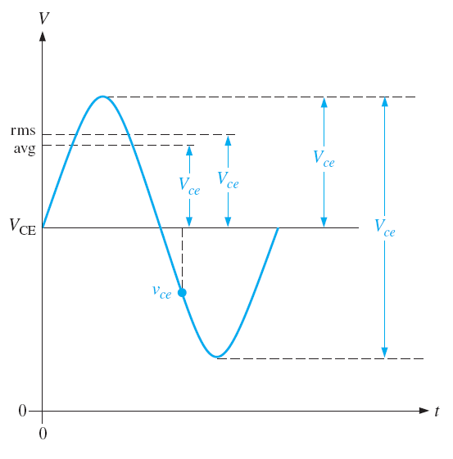
Amplifiers
1-1:Amplifier Operation: The biasing of a transistor is purely a dc operation to establish a Q-point about which variations in current and voltage can occur in response to an ac input signal
AC Quantities
ac and dc quantities are usually represented by capital letters with a change in the subscripts
  dc quantities: capital non-italic subscripts like I_{B}, I_{C}, I_{E}, V_{C}, V_{E}, V_{CE}
  ac quantities: small italic subscripts, for example, I_{c}, I_{e}, I_{b}, V_{c}, and V_{ce}
ac quantities may be represented in rms, average, peak, peak to peak. rms values will be used unless otherwise stated.
Representation of V_{ce}
instantaneous
ac instantaneous quantities are represented by small letters with Lowercase small italic subscripts like i_{c}, i_{e}, i_{b}, v_{c}, and v_{ce}
Resistance is also identified with a small letter of small subscript when analyzed from an ac standpoint.

Slide 2
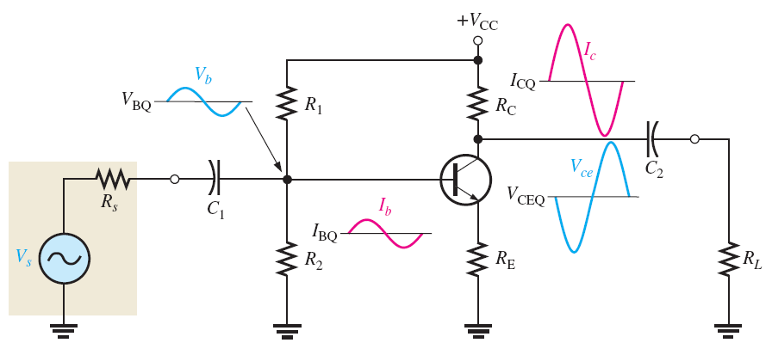
1-1:Amplifier Operation:
The linear amplifier
A linear amplifier provides amplification of a signal without any distortion → output signal is an exact amplified replica of the input signal.
ac source of internal resistance R_{s} coupled to the base through C₁
Load resistance R_{L} coupled to the collector through C₂
The coupling capacitors block dc and thus prevent R_{s} and R_{L} from changing the dc bias voltages at the base and collector.
For the amplifier shown, notice that the voltage waveform is inverted between the input V_{b}and output V_{ce} but has the same shape.

Slide 3
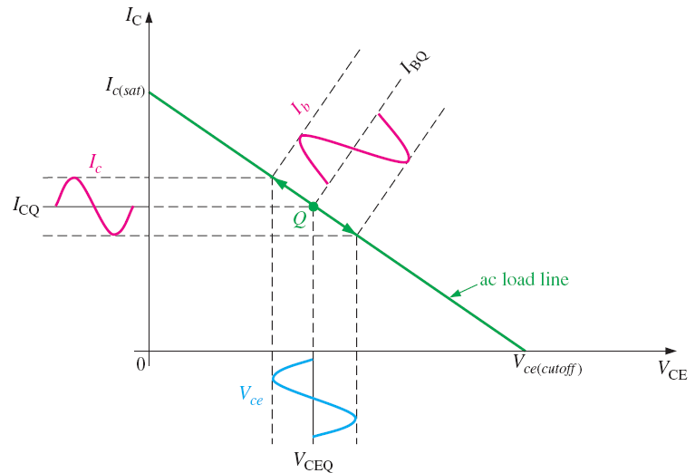
1-1:Amplifier Operation:
AC Load Line
Operation of the linear amplifier can be illustrated using an ac load line as shown.
The ac load line is different than the dc load line because a capacitor looks open to dc but effectively acts as a short to ac → the collector resistor R_{C} appears to be in parallel with the load resistor R_{L}.

Slide 4
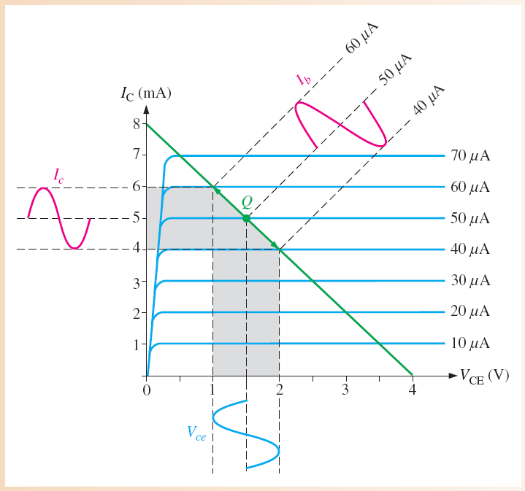
1-1:Amplifier Operation:
Example: a) Determine the resulting peak-to-peak values of collector current and collector-to-emitter voltage from the graph. b) What are the dc Q-point values
a)
collector current varying from 4 mA to 6 mA → collector current has peak-to-peak value of 2 mA
(I_{c} = 2 mA)
And V_{ce} = 1 V
b)
I_{BQ} = 50 μA
I_{CQ} = 5mA
V_{CEQ} = 1.5V

Slide 5
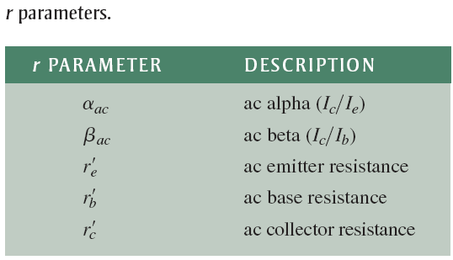
1-2: Transistor AC Models:
A transistor in an amplifier circuit can be represent by a model circuit. The transistor model circuit based on various internal transistor resistance parameters r that can represent its operation.
Five resistance parameters (r-parameters) can be used for detailed analysis of a BJT circuit. For most analysis work, the simplified r-parameters give good results.

Slide 6
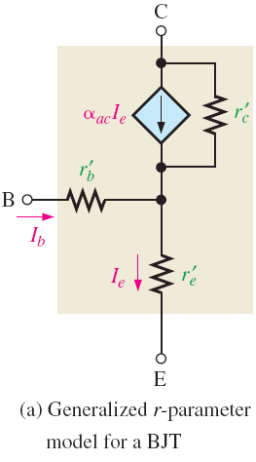
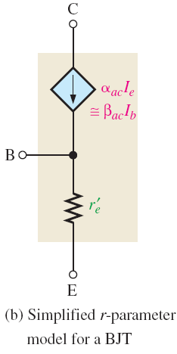
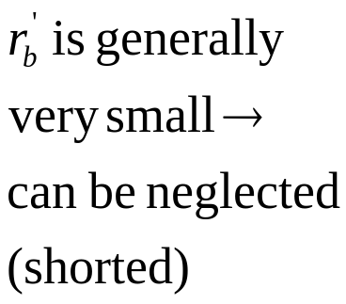
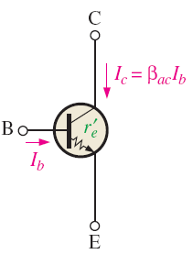
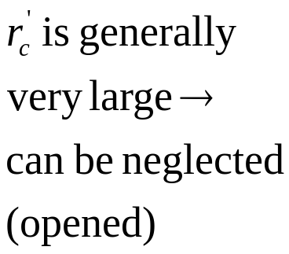

1-2: Transistor AC Models:
r-Parameter Transistor Model
Simplified to
Hence for simplified r-parameter, we have only to be used. can be derived assuming an abrupt p-n junctions →
At 20 °C

Slide 7

1-2: Transistor AC Models:
Determining by a Formula
For the simplified r-parameter, we have only to be considered. can be derived assuming an abrupt p-n junctions →
At 20 °C
Example: Determine the of a transistor that is operating with a dc emitter current of 2 mA.

Slide 8
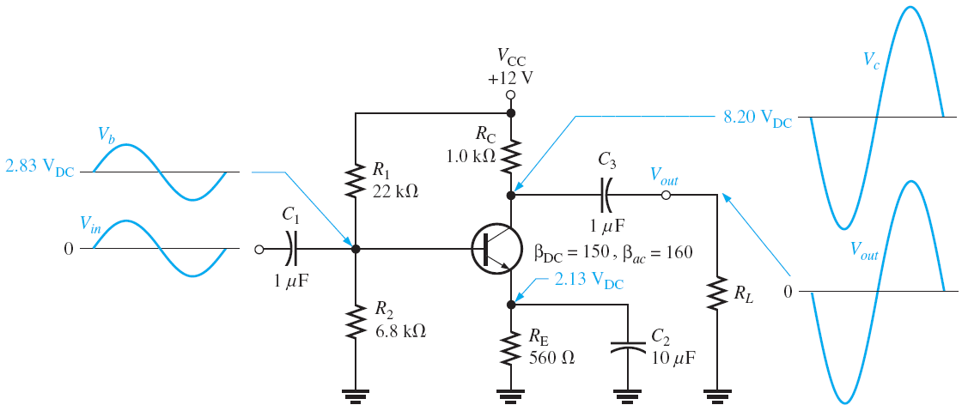
1-3: The Common-Emitter Amplifier
In the common-emitter (CE) amplifier, the input signal is applied to the base and the inverted output is taken from the collector. The emitter or ground is common to ac signals (V_{in} and V_{out}) as shown. CE amplifiers has high voltage gain and high current gain.
A common-emitter amplifier with voltage-divider bias and coupling capacitors C₁ and C₃ on the input and output and a bypass capacitor, C₂, from emitter to ground. Output voltage has a 180° phase difference from input voltage.

Slide 9
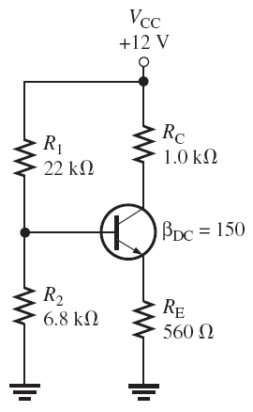
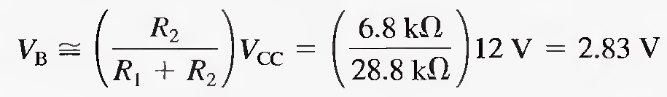
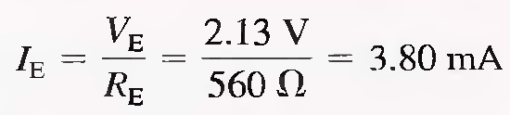

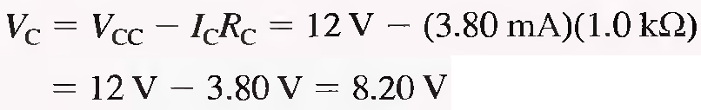
1-3: The Common-Emitter Amplifier
DC analysis
Considering CE amplifier circuit above, dc analysis can be done by removing the coupling and bypass capacitors. Capacitors appear open with dc connected → only we will have the voltage divider bias circuit shown.
Using thevenin equivalent for bias circuit (see Ch. 5) →
R_{IN(base)} > 10 R₂ → stiff voltage divider ➔

Slide 10


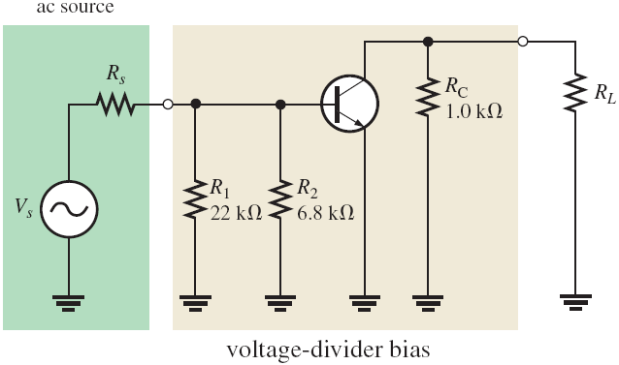
1-3: The Common-Emitter Amplifier
AC analysis
Ac equivalent circuit can be developed by considering:
1- The capacitors are replaced by effective shorts because their values
are selected so that the capacitive resistance X_{C} is negligible at the signal frequency and can be considered to be 0 Ω.
* Note that C₂ must be large enough so that X_{C2}
is very small compared to R_{E} ( )
At given frequency. X_{C} can be calculated using the relation
2- The dc source is replaced by ground. No ac voltage can be developed across it so it appears as an ac short. This is why a dc source is called an ac ground. ➔ the ac equivalent circuit for CE amplifier is

Slide 11






1-3: The Common-Emitter Amplifier
AC analysis: input and output resistances
the total input resistance for voltage divider bias circuit for the input ac voltage is
Where R_{in(base)} for ac is
also
➔ R_{s} is series with R_{in(tot)} →
the output resistance for voltage divider bias circuit is the resistance looking in at the collector
➔ Hence when R_{L} is capacitively coupled with the circuit, The total output resistance (ac resistance R_{c} seen by the collector) is R_{C}||R_{L} →

Slide 12
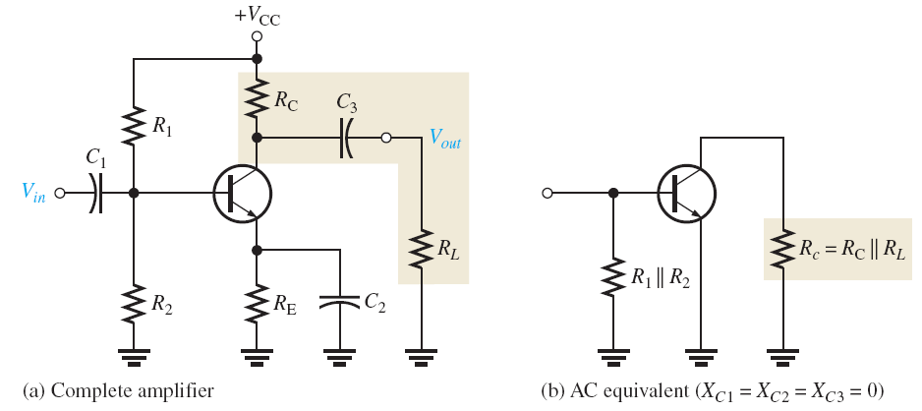



1-3: The Common-Emitter Amplifier
AC analysis: Voltage gain
ac equivalent circuit for the bias circuit capacitively coupled with R_{L} is
With no load, the voltage gain for ac voltage is (see Ch. 4)
If C₂ is removed →

Slide 13


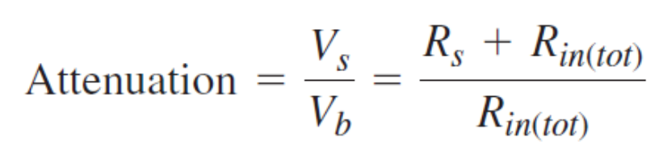
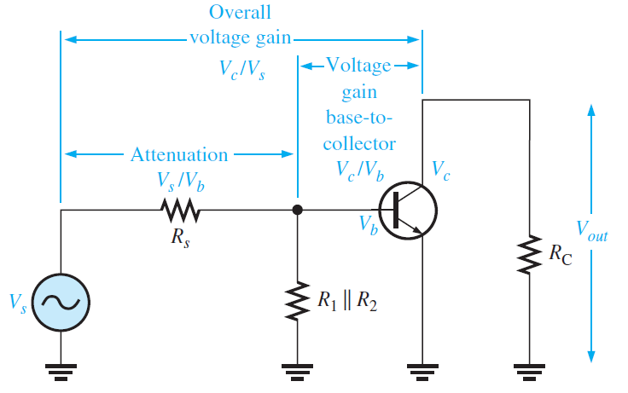

1-3: The Common-Emitter Amplifier
AC analysis: Voltage gain
With load resistance R_{L} → ac resistance seen by the collector is R_{c}=R_{C}||R_{L} →
If C₂ is removed →
To get the overall gain of the amplifier from the source voltage to collector, the attenuation (reduction in signal voltage) of the input circuit must be included.
The overall voltage gain of the amplifier
Reciprocal of the attenuation

Slide 14
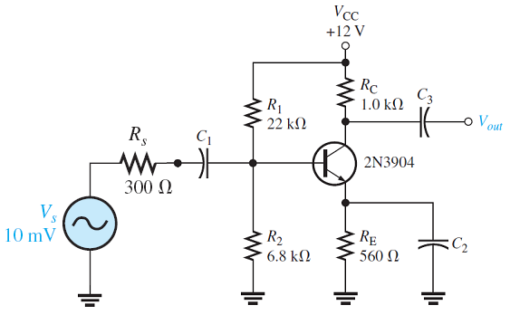

1-3: The Common-Emitter Amplifier
AC analysis: Example: for the amplifier shown below, calculate (a) the signal voltage at the base (V_{b}), (b) the minimum value for the emitter bypass capacitor, C₂, if the amplifier must operate over a frequency range from 200 Hz to 10 kHz., (c) Calculate the base-to-collector voltage gain of the amplifier (without and with C₂) if there is no load resistor, (d) If a load resistor of 5kΩ is added at V_{out}, calculate the voltage gain (include C₂), and (e) the overall voltage gain if C₂ and R_{L} are included (e) the signal voltage at the collector

Slide 15
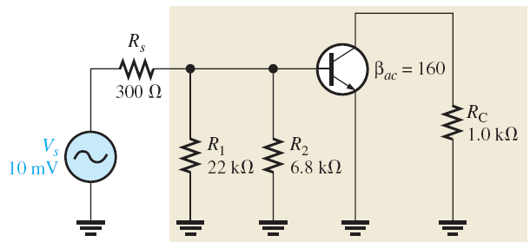




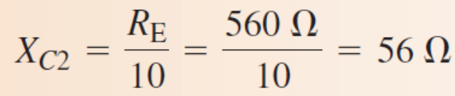

1-3: The Common-Emitter Amplifier
AC analysis: Example – continued.
The Ac equivalent circuit of above circuit is shown in the figure below
(a) From above dc analysis I_{E} = 3.8 mA
hence
(b) The X_{C} of the bypass capacitor, C₂, should be at least ten times less than R_{E}.

Slide 16
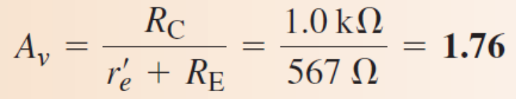
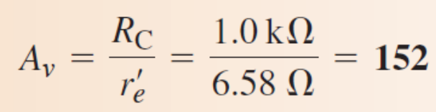

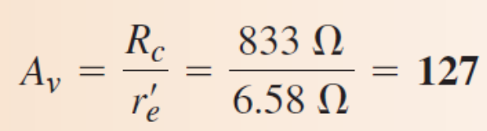
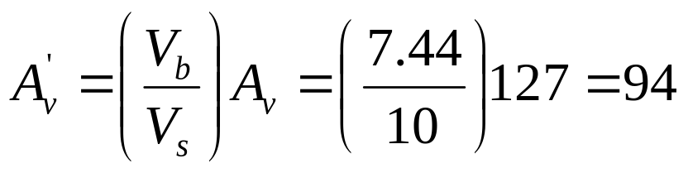
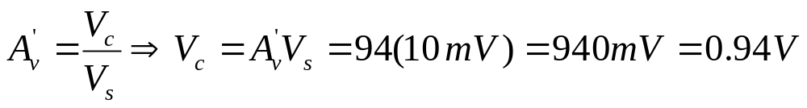
1-3: The Common-Emitter Amplifier
AC analysis: Example – continued from previous
(c)
Without C₂
With C₂
(d)
With R_{L} and C₂ included
(e)
The overall voltage gain is (C₂ and R_{L} are included)
(f) The signal voltage at the collector V_{c}

Slide 17


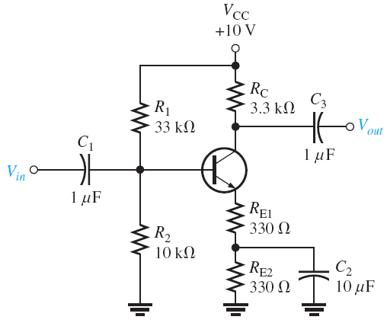


1-3: The Common-Emitter Amplifier
AC analysis: Addition of Swamping Resistor.
voltage gain is essentially depends on specially when R_{E} is bypassed by C₂. Since changes with temperature → the voltage gain becomes unstable. On the other hand, removing C₂ cause the gain to go to its lowest value. Hence we can add a swamping resistor (R_{E1}) to reduce the effect of
→ Greater gain stability can be achieved and the gain will be lower as a result.
→ The voltage gain for the circuit shown becomes:
(if R_{E1} > 10 )
and
If = 20 Ω for the transistor →
READ CAREFULLY EXAMPLE 6-8 page 272

Slide 18
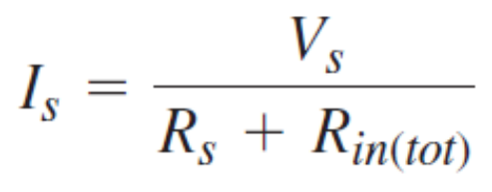
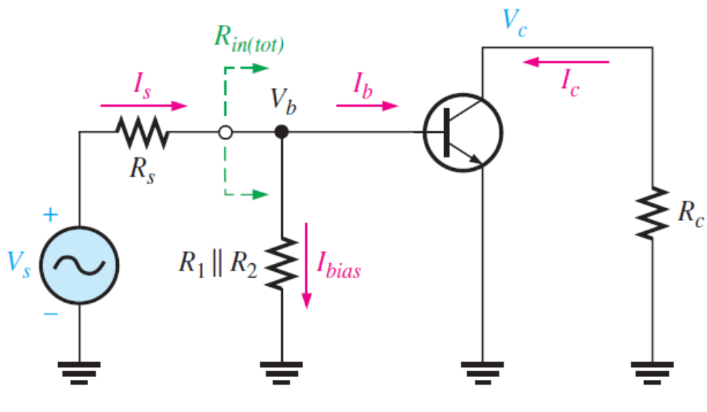
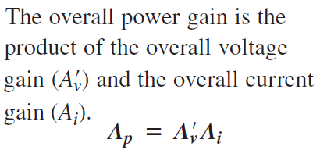
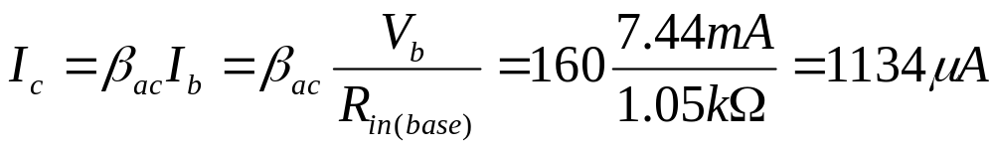
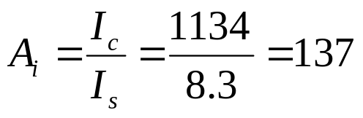
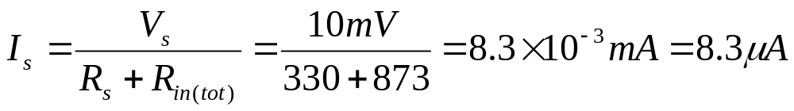

1-3: The Common-Emitter Amplifier
AC analysis: current gain
where
AC analysis: power gain
Ex. In the example before, calculate the overall current gain and power gain
Current gain
Power gain

Slide 19
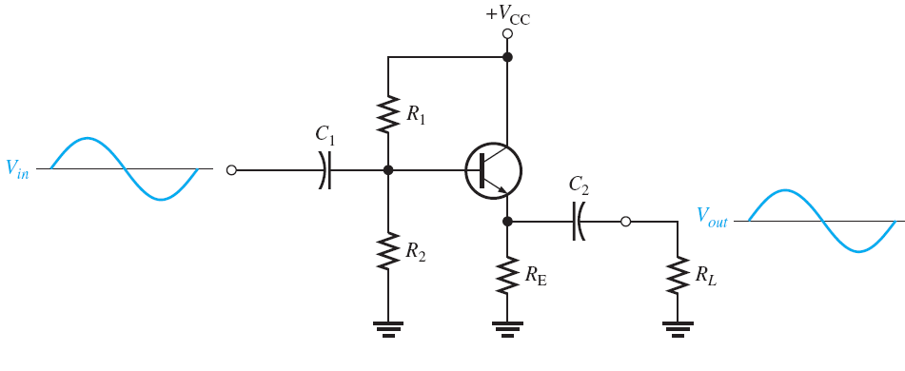
1-4: The Common-collector Amplifier
The common-collector (CC) amplifier is usually referred to as an emitter-follower (EF). The input is applied to the base through a coupling capacitor, and the output is at the emitter (no phase change between input and output). The voltage gain of a CC amplifier is approximately 1, and its main advantages are its high input resistance and current gain. The high input resistance is very useful to minimize the loading effect specially when circuit is driving a low-resistance load→ CC amplifier is used as a Buffer.

Slide 20


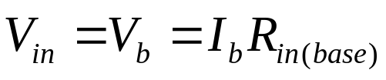



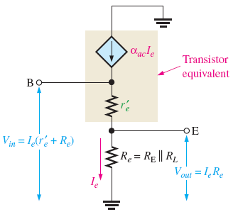

1-4: The Common-collector Amplifier
Voltage Gain
The voltage gain is usually can be calculated with the help of ac equivalent for input and output voltage shown.
and
Therefore the voltage gain
If R_{e}>> , which is the Usual case

Slide 21








1-4: The Common-collector Amplifier
Input Resistance
For ac the total input resistance is
Where
If R_{e}>> →
Output Resistance
Current Gain
Power Gain
since
Power gain

Slide 22
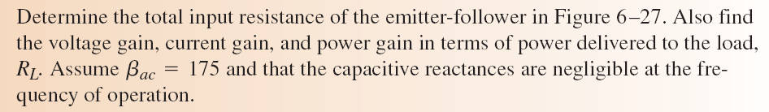


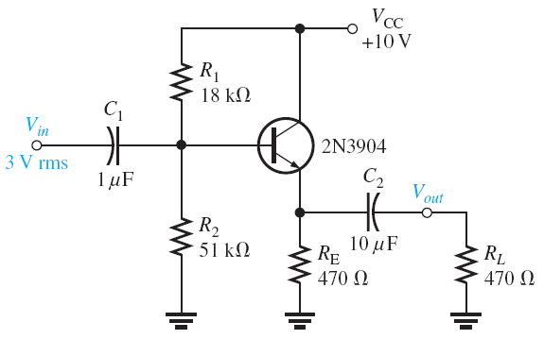

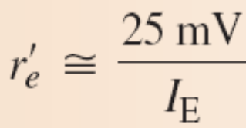





1-4: The Common-collector Amplifier: Example
1
where
and
2
but
and

Slide 23

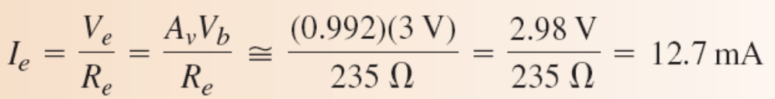
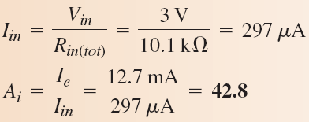


1-4: The Common-collector Amplifier: Example
3. The current gain
4. The power gain is
Since R_{L}=R_{E} → half power gain will be for the load

Slide 24


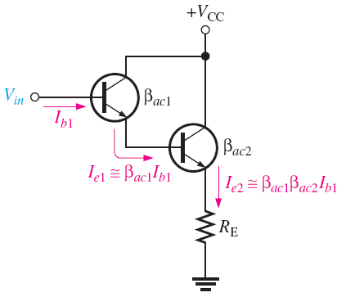
1-4: The Common-collector Amplifier: Example
The Darlington Pair:
A Darlington pair is two transistors connected as shown (with common collector). The Darlington pail highly increase the input resistance → better circuit (better Buffer) specially when using low-load resistance. The two transistors act as one “super β” transistor. Darlington transistors are available in a single package. Notice there are two diode drops from base to emitter →
➔
(assuming R_{E} >> )
→ With Darlington pair we have better buffering (barrier between input and output) in addition to high current gain

Slide 25
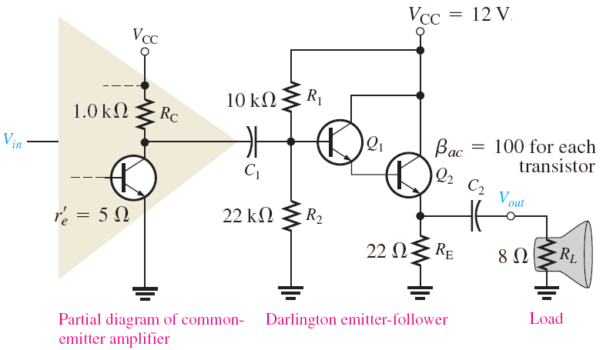


1-4: The Common-collector Amplifier: Example
The Darlington Pair:
Emitter Followers like Darlington is usually used as an interface between a circuit of high output resistance (like CE amplifier) and a low–load resistance
Without CC Darlington and without Load R_{L} →
Without CC Darlington and with Load R_{L} → R_{C}//R_{L} ➔
When adding Darlington before R_{L}→ overall voltage gain becomes
FOR MORE DETAILS SEE EXAMPLE 6-10 p. 281

Slide 26
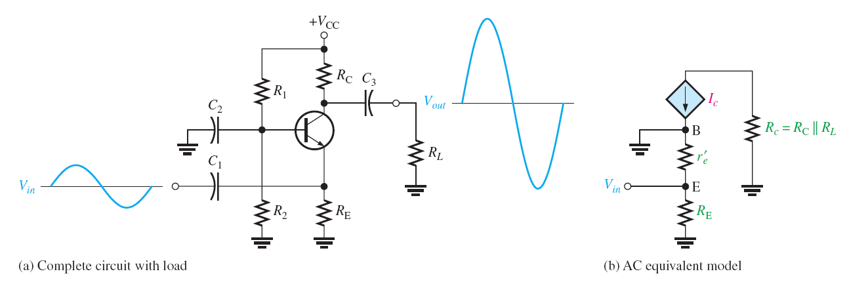
1-4: The Common-Base Amplifier
The common-base (CB) amplifier provides high voltage gain with a maximum current gain of 1. Since it has a low input resistance.
A typical common-base amplifier is shown in figure below. The base is the common terminal and is at ac ground because of capacitor C₂. The input signal is capacitively coupled to the emitter. The output is capacitively coupled from the collector to a load resistor.

Slide 27
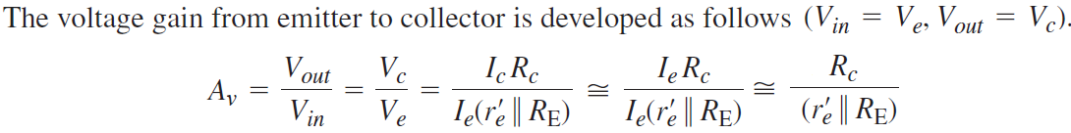







1-4: The Common-Base Amplifier
Voltage Gain
Input Resistance
Output Resistance:
Current Gain:
Power Gain:

Slide 28


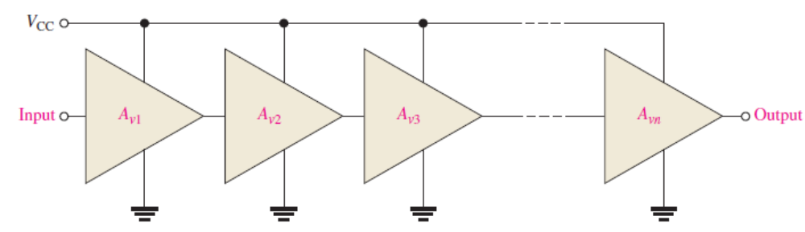

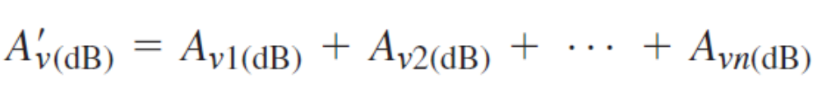
1-4: Multistage amplifiers
Two or more amplifiers can be connected in a cascaded arrangement with the output of one amplifier driving the input of the next. The basic purpose of a multistage arrangement is to increase the overall voltage gain
The overall voltage gain, , of cascaded amplifiers, as shown in the figure, is the product of the individual voltage gains.
Also amplifier voltage gain is often expressed in decibels (dB) as follows:
This is particularly useful in multistage systems because the overall voltage gain in dB is the sum of the individual voltage gains in dB.

Slide 29
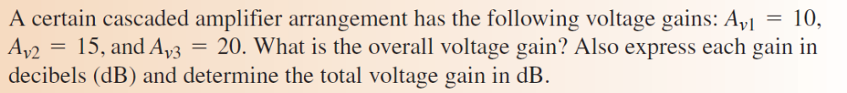
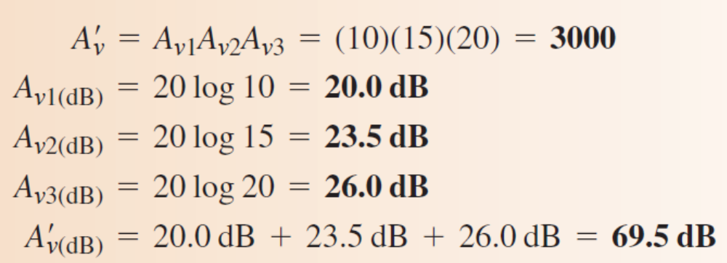
1-4: Multistage amplifiers: Example

Slide 30

1-4: Multistage amplifiers: Capacitively coupled
Two-stage capacitively coupled amplifier is shown in Figure below. Notice that both stages are identical common-emitter amplifiers with the
output of the first stage capacitively coupled to the input of the second stage. Capacitive coupling prevents the dc bias of one stage from affecting that of the other
The DC biasing is same for both stages and is identical for common emitter dc biasing discussed before (V_{B}, V_{E}, V_{C}, I_{B}, I_{E}, I_{C}, and V_{CE})

Slide 31






1-4: Multistage amplifiers: Capacitively coupled
The ac equivalent circuit for the first stage is show below
Ac input resistance of second stage is like a load for the first stage
For the second stage with no load → R_{c2} = R_{C} = R₇
→ Overall voltage gain is:
or In decibel (dB)
Multistage amplifier can be done by direct coupling without capacitor. The dc collector voltage of the first stage provides the base-bias voltage for the second stage. This type of amplifier has a better low-frequency response than the capacitively coupled type

